Slide 1

Verkenning van package stats binom.test en chisq.test

Slide 2
library(help = "stats")
Information on package ‘stats’
Description:
Package: stats
Version: 3.0.2
Priority: base
Title: The R Stats Package
Author: R Core Team and contributors worldwide
Maintainer: R Core Team <R-core@r-project.org>
Description: R statistical functions
License: Part of R 3.0.2
Built: R 3.0.2; x86_64-w64-mingw32; 2013-09-25 15:39:42 UTC; windows
Dan volgt een index van vijf bladzijden, waaruit ik enkele
items geplukt heb.

Slide 3
Index: (een selectie eruit)
Binomial The Binomial Distribution
Chisquare The (non-central) Chi-Squared Distribution
IQR The Interquartile Range
chisq.test Pearson’s Chi-squared Test for Count Data
lm Fitting Linears Models
lowess Scatter Plot Smoothing
median Median Value
na.action NA Action
na.fail Handle Missing Values in Objects
quantile Sample Quantiles
read.table Manipulate Flat Contingency Tables
sd Standard Deviation
xtabs Cross Tabulation

Slide 4
?binomial
The Binomial Distribution
Description
Binomial {stats} | R Documentation
The Binomial Distribution
Description
Density, distribution function, quantile function and random generation for the binomial distribution with parameters size and prob.
Usage
dbinom(x, size, prob, log = FALSE)
pbinom(q, size, prob, lower.tail = TRUE, log.p = FALSE)
qbinom(p, size, prob, lower.tail = TRUE, log.p = FALSE)
rbinom(n, size, prob)
Arguments
Etc.

Slide 5
dbinom(x=3,size=20,prob=1/6)
0.2378866
of
dbinom(3,20,1/6)
0.2378866

Slide 6
dbinom(0:4,4,1/2)
[1] 0.0625 0.2500 0.3750 0.2500 0.0625
sum(dbinom(0:4,4,1/2))
[1] 1
plot(dbinom(0:4,4,1/2),col="red")

Slide 7
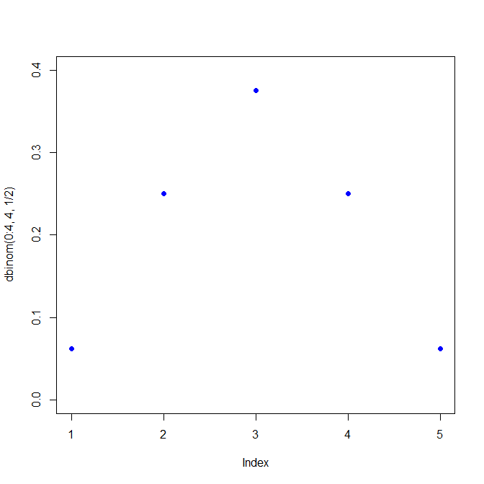
plot(dbinom(0:4,4,1/2),pch=16,ylim=c(0,0.40),col=4) # zoek uit hoe je 0,1,2,3,4 onder de punten krijgt, langs de x-as.
# zoek uit hoe je zinnige tekst langs de assen krijgt.

Slide 8
binom.test {stats} R Documentation Exact Binomial Test
Description
Performs an exact test of a simple null hypothesis about the probability of success in a Bernoulli experiment.
Usage
binom.test(x, n, p = 0.5, alternative = c("two.sided", "less", "greater"), conf.level = 0.95)
Arguments
x number of successes, or a vector of length 2 giving the numbers of successes and failures, respectively. n number of trials; ignored if x has length 2.
p hypothesized probability of success. alternative indicates the alternative hypothesis and must be one of "two.sided", "greater" or "less". You can specify just the initial letter.
conf.level confidence level for the returned confidence interval.

Slide 9
Binomial test example 1 # dit is een toets
# Under (the assumption of) simple Mendelian inheritance, a cross between plants of two particular genotypes produces progeny 1/4 of which are "dwarf" and 3/4 of which are "giant“.
In an experiment to determine if this assumption is reasonable, a cross results in progeny
having 243 dwarf and 682 giant plants. If "giant" is taken as success, the null hypothesis is that
p = 3/4 and the alternative that p ≠ 3/4.
binom.test(682,682+243, p = 3/4 )
# or
binom.test(c(682, 243), p = 3/4)
# x number of successes, or a vector of length 2 giving the numbers of successes and failures, respectively.
n number of trials; ignored if x has length 2.

Slide 10
binom.test(c(682, 243), p = 3/4) # Output:
Exact binomial test
data: c(682, 243)
number of successes = 682, number of trials = 925,
p-value = 0.3825
alternative hypothesis: true probability of success is not equal to 0.75
95 percent confidence interval: 0.7076683 0.7654066
sample estimates: probability of success 0.7372973

Slide 11
Binomial test example 2
binom.test(107,1000,p=0.1, alternative="less")
# output
Exact binomial test
data: 107 and 1000
number of successes = 107, number of trials = 1000, p-value = 0.787
alternative hypothesis: true probability of success is less than 0.1
95 percent confidence interval: 0.0000000 0.1244477
sample estimates: probability of success 0.107

Slide 12
Binomial test example 3
binom.test(107,1000,p=0.1, alternative="less", conf.level=0.99)
Exact binomial test
data: 107 and 1000
number of successes = 107, number of trials = 1000, p-value = 0.787
alternative hypothesis: true probability of success is less than 0.1
99 percent confidence interval: 0.0000000 0.1318234
sample estimates: probability of success 0.107

Slide 13
?chisq.test
Description
chisq.test performs chi-squared contingency table tests and
goodness-of-fit tests.
Usage
chisq.test(x, y = NULL, correct = TRUE, p = rep(1/length(x), length(x)),
+ rescale.p = FALSE, simulate.p.value = FALSE, B = 2000)
Arguments
x a numeric vector or matrix. x and y can also both be factors.
y a numeric vector; ignored if x is a matrix. If x is a factor, y should be
a factor of the same length.

Slide 14
Chisq.test example 1 # goodness of fit
x <- c(A = 20, B = 15, C = 25) # hier staan de geobserveerde waarden
chisq.test(x)
Chi-squared test for given probabilities
data: x X-squared = 2.5, df = 2, p-value = 0.2865

Slide 15
Chisq.test example 2
#goodness of fit
x <- c(89,37,30,28,2) # hier staan de geobserveerde waarden
p <- c(0.30,0.20,0.20,0.19,0.11) # is samen 1
# hier staan de verwachte verhoudingen
chisq.test(x, p = p)
Chi-squared test for given probabilities
data: x
X-squared = 39.328, df = 4, p-value = 5.96e-08

Slide 16
Chisq.test example 3
goodness of fit
x <- c(89,37,30,28,2)
p <- c(40,20,20,15,5) # is samen 100 (%)
chisq.test(x, p = p, rescale.p = TRUE)
Chi-squared test for given probabilities
data: x
X-squared = 9.9901, df = 4, p-value = 0.04059

Slide 17
Chi-Square Test for independence in R (Zie MarinStatsLectures R Tutorial 4.7 eerste 3 minuten)
https://www.youtube.com/watch?v=POiHEJqmiC0&index=34&list=PLqzoL9-eJTNBDdKgJgJzaQcY6OXmsXAHU

Slide 18

Verantwoording
In deze powerpoint is géén auteursrechtelijk beschermd werk opgenomen
Alle teksten © Wilma Groenwegen/HAN tenzij expliciet externe bronnen zijn aangegeven
Screenshots op basis van eigen werk auteur en/of vernoemde sites
Eventuele images zijn opgenomen met vermelding van bron

